Slide 1

Break Even Analysis
A Primer

Slide 2
Concept of CVP Analysis
Cost volume analysis is a technique of analysis to study the effects of cost and volume variations on profit.
It seeks to measure the effect of changes in volume, cost, price and products-mix on profits.

Slide 3
CVP Analysis
CVP analysis measures the effect of :
Price changes on net profit,
volume changes on net profit,
price and volume changes on net profit,
an increase or decrease in variable costs on net profit,
an increase or decrease in fixed costs on net profit,
all four factors viz., price, volume, variable costs, and fixed costs on net profit

Slide 4
BEP Analysis
CVP analysis explores the fundamental relationship between cost -volume-profit variables.
Change in volume influence cost and profit and, a stage is reached when cost is equated with revenue at a certain level of output or at a certain volume of sales. This is said as `break-even point.'
So BEP analysis is a part of CVP analysis.

Slide 5
BEP
It is a point where sales revenue equals the costs to make and sell the product and no profit or loss is reported.
In the words of Keller and Ferrara, “the break even point of a company or a unit of a company is the level of sales income which will equal to the sum of its fixed costs and variable costs.”
C. T. Horngren define it, “the break even point is that point of activity (sales volume) where total revenues and total expenses are equal, it is the point of zero profit and zero loss.”

Slide 6
Computation of BEP
1. Mathematical method:
Equation Method –
Sales – Variable costs – Fixed cost = Profit (S --- VC – FC = P)
Sales – Variable costs = Fixed costs + Profit (S --- VC = FC + P)
Sales minus variable costs is called Contribution. (S --- VC = C)
Contribution = Fixed costs + Profit (C = FC + P)
At break even point, profit is zero.
∴ Contribution = Fixed Costs (at break even point)
Or (SP ---- VC) Q = F
Here SP is selling price, VC is the variable costs;
F is a fixed costs and Q is the number of units produced and sold.

Slide 7
Illustration
Calculate the break even point from the following information :
Selling price = Rs. 3 per unit, Variable cost = Rs. 2 per unit, Fixed cost = Rs. 90,000. Estimated sales for the period = 100,000 units or Rs. 300,000.
Suppose the units to be produced and sold at break even point is Q, then -
Sales – Variable Costs = Contribution = Fixed Costs
3 Q – 2 Q = 90,000
Q = 90,000 units.
When we produce and sell 90,000 units, then total sales revenue is Rs. 2,70,000 , (90,000 units × Rs. 3 )
Total cost is Rs. 2,70,000,
(VC Rs. 2 × 90000)1,80,000 + F C Rs. 90,000)

Slide 8
Contribution Margins Technique
Contribution per unit means difference between
Selling price and variable costs.
or
Contribution per unit =
Selling price per unit – Variable Cost per unit
Total Contribution = Sales Revenue – Total VC.

Slide 9
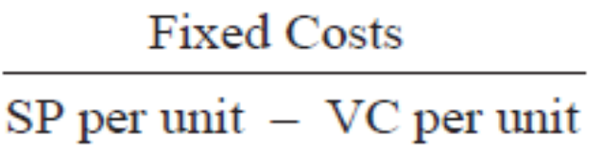

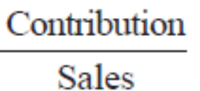
Contribution Margins Technique
BEP in Units =
BEP in Value =
PV Ratio =

Slide 10
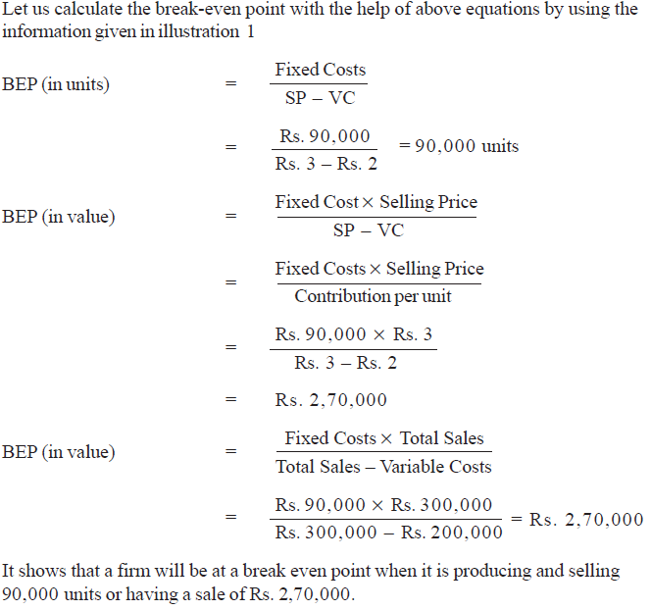

Slide 11
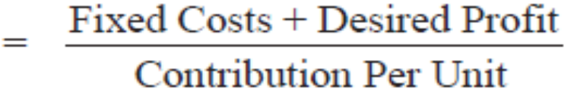
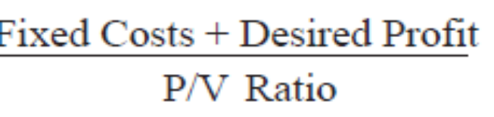
Required Sales for desired profit
BEP can be used to estimate the profit at different levels of production.
1. In Units
2. In Value =

Slide 12
Illustration
A Company producing a single product and sells it at Rs. 10 per unit.
Variable cost is Rs. 6 per unit and fixed cost is Rs. 40,000 per annum.
Compute a) Break even point &
b) Sales volume required to earn a profit of Rs. 60,000 per annum.

Slide 13
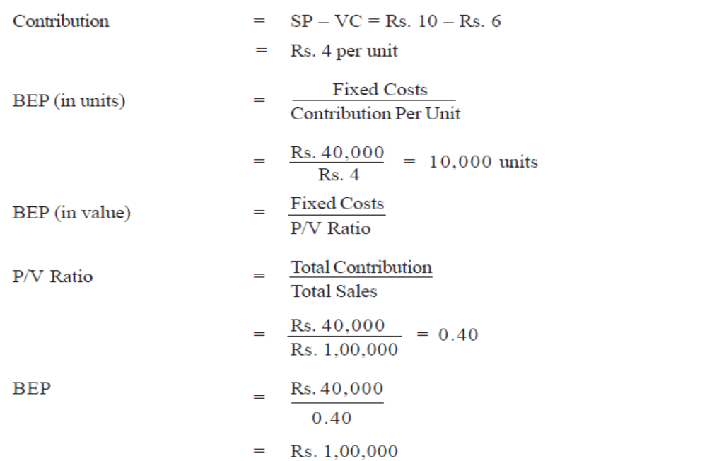
Solution

Slide 14
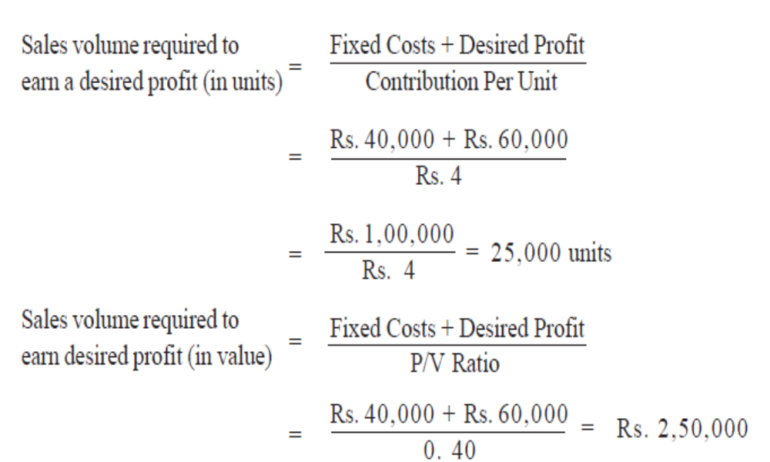
Solution

Slide 15
Practice

